Slide 1

Fine-Tuning Models Part 4

Slide 2
What We Will Cover
Understanding Pre-Training
Understanding Fine-Tuning
When to Use Fine-Tuning
Preparing Training Data
Cost Calculations
Train / Test Split
Creating Fine-Tuning Jobs
Analyzing the Training Metrics
Exploring Fine-Tuning Jobs
Understanding Checkpoints
Exploring Fine-Tuning Events
Using Fine-Tuned Models
Fine-Tuning Use Cases
Integrations

Slide 3
Train / Test Split

Slide 4
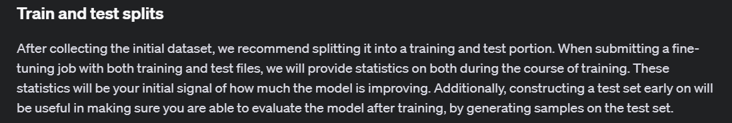
Notes:
https://platform.openai.com/docs/guides/fine-tuning/train-and-test-splits

Slide 5
Why Train / Test Split?
Model Evaluation:
Prevent Overfitting: By evaluating a model on unseen data, we can assess its generalization capability. Overfitting occurs when a model learns the training data too well, including noise and outliers, leading to poor performance on new data.
Estimate Performance: It provides a more accurate estimate of how the model will perform in real-world scenarios by testing it on data that was not used during training.
Validation:
Hyperparameter Tuning: Splitting the data into training and validation sets allows for tuning hyperparameters in a way that mimics real-world performance without biasing the model.
Model Selection: Helps in comparing different models or algorithms by evaluating their performance on the same test set. Prevention of Data Leakage:Data Integrity: Ensures that information from the test set does not leak into the training process, maintaining the integrity and validity of the evaluation.

Slide 6
Demo: Creating a Train / Test Split
def split_jsonl_file(file_path, train_ratio=0.8):
# Read the input file
file_path = Path(file_path)
with file_path.open('r', encoding='utf-8') as f:
data = [json.loads(line) for line in f]
# Shuffle the data
random.shuffle(data)
# Calculate split index
split_index = int(len(data) * train_ratio)
# Split the data
train_data = data[:split_index]
test_data = data[split_index:]

Slide 7



Notes:
https://www.youtube.com/channel/UC35ZpwldGw7ZJ5R-2sLijzw

Slide 8
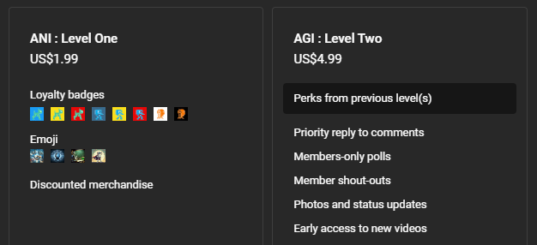

Membership has its privileges
Notes:
https://www.youtube.com/channel/UC35ZpwldGw7ZJ5R-2sLijzw/join

Slide 9

https://www.youtube.com/@AINewsFresh

Slide 10
Creating a Fine-Tuning Job

Slide 11
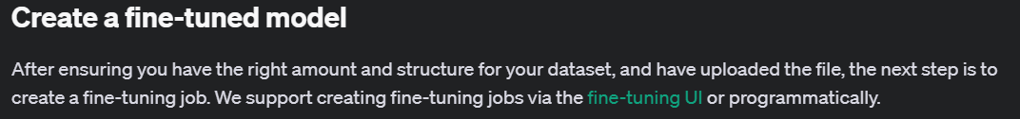
Notes:
https://platform.openai.com/docs/guides/fine-tuning/create-a-fine-tuned-model

Slide 12
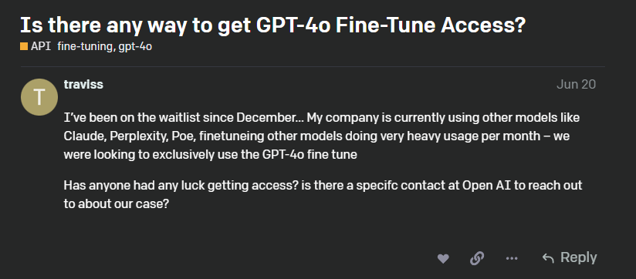
Get Access to the Better Models
Notes:
https://community.openai.com/t/is-there-any-way-to-get-gpt-4o-fine-tune-access/831437

Slide 13
Demo: Creating a Simple Fine-Tuning Job (Code)
# Create a fine-tuning job using the uploaded training data
client.fine_tuning.jobs.create(
training_file=fine_tune_file.id,
model="gpt-4o-mini-2024-07-18"
)

Slide 14
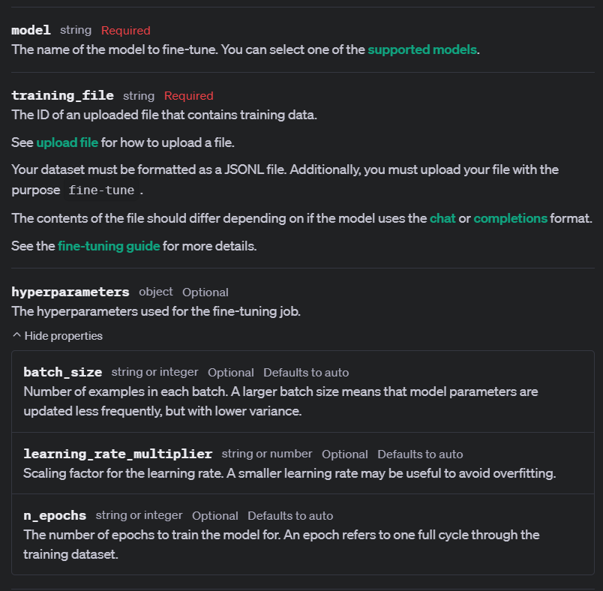
Notes:
https://platform.openai.com/docs/api-reference/fine-tuning/create

Slide 15
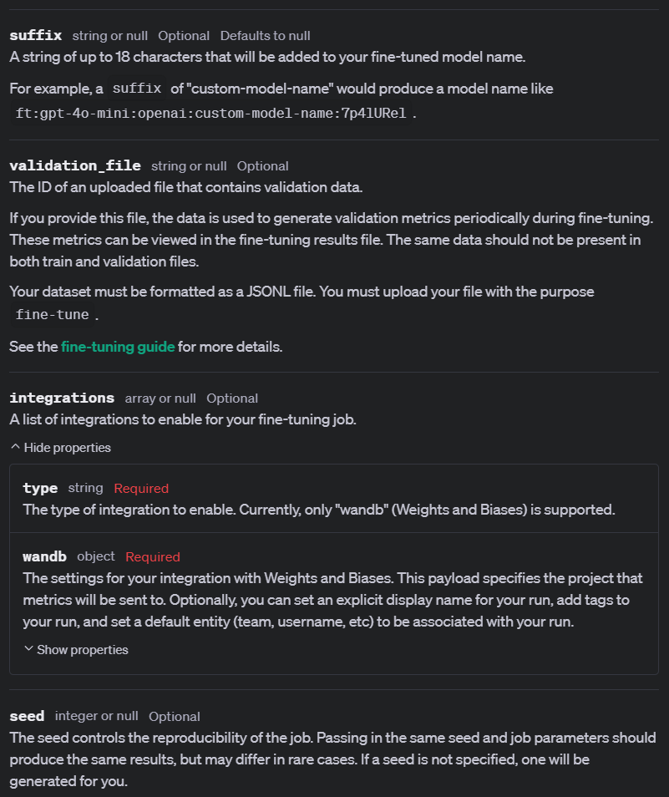
Notes:
https://platform.openai.com/docs/api-reference/fine-tuning/create

Slide 16

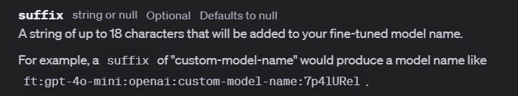
Make Sure to Name Your Models

Slide 17
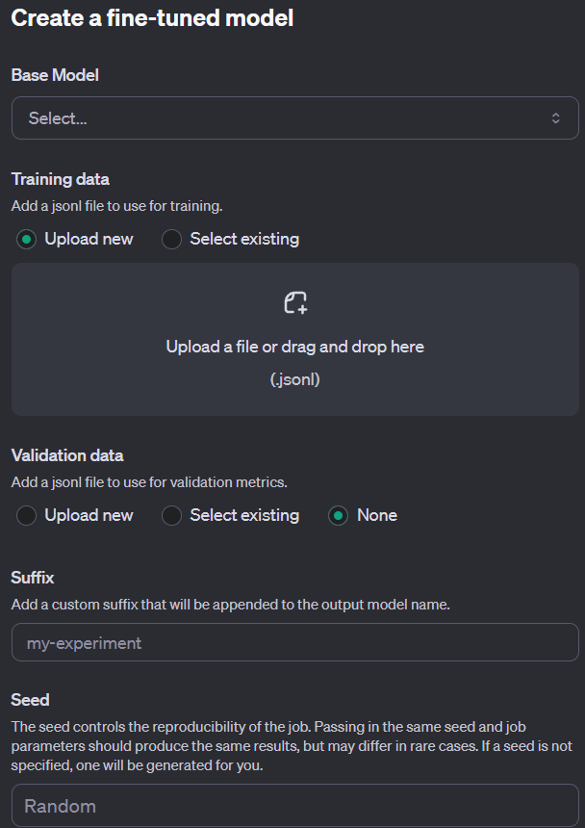
Demo: Creating a Simple Fine-Tuned Model (UI)

Slide 18
Demo: Creating a Fine-Tuning Job with All Parameters
# Create a fine-tuning job using the uploaded training data
my_ft_job = client.fine_tuning.jobs.create(
model="gpt-4o-mini-2024-07-18",
training_file=fine_tune_file.id,
validation_file=None,
hyperparameters={
"batch_size": "auto",
"learning_rate_multiplier": "auto",
"n_epochs": "auto",
},
suffix=“marv_fine_tune”,
integrations=None,
seed=None,
)

Slide 19
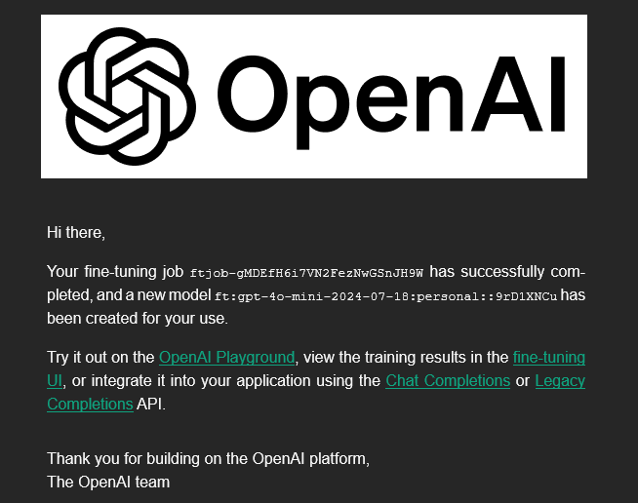
Notification Email

Slide 20
Watch Out for Per-Model Limits
RateLimitError:
Error code: 429 - {'error’: {
'message': "This fine-tune request has been rate-limited. Your organization has reached the maximum of 10 fine-tuning requests per day for the model 'gpt-4o-mini-2024-07-18'.",
'type': 'invalid_request_error’,
'param': None,
'code': 'daily_rate_limit_exceeded’}
}

Slide 21


